Slide 1
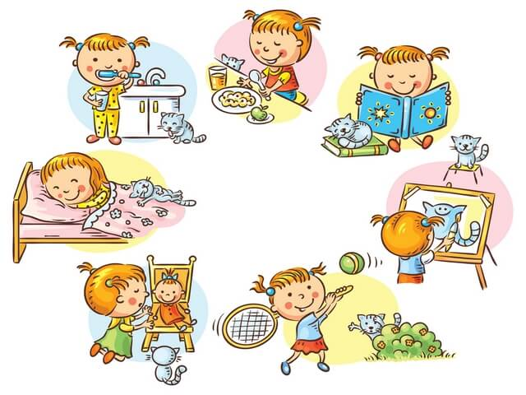

Slide 2
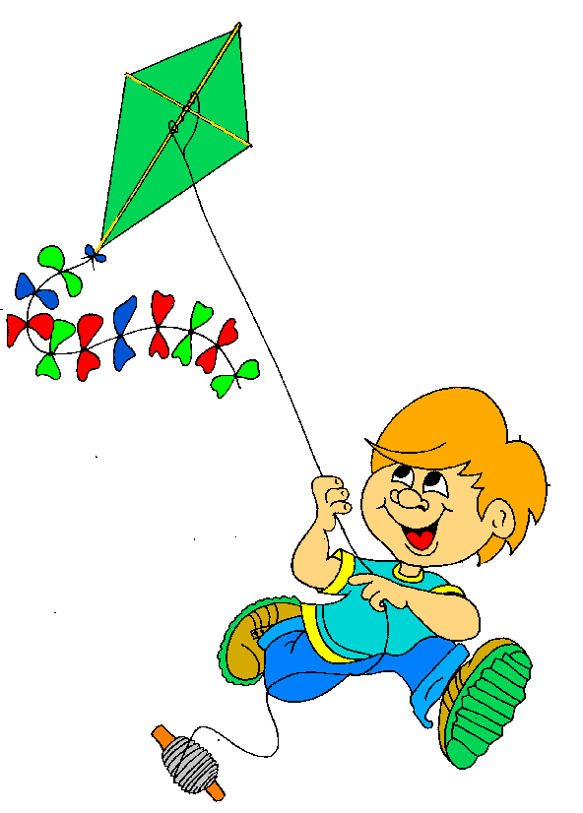
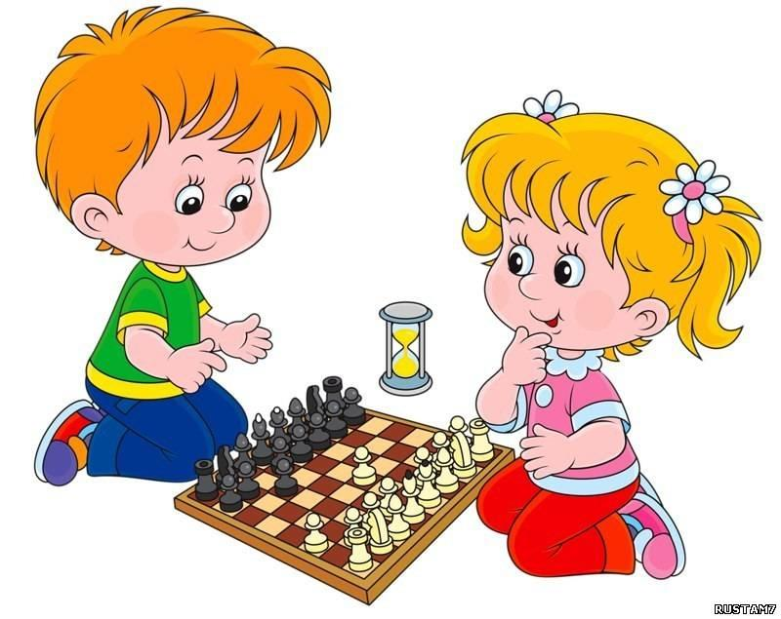
1
3
5
2
4
1
 |  | 2
 |  | 3
 |  |  |  | 4
 |  |  | 5
1 | d | o |  | h | o |  | m | e | w | o | r | k
 |  | 2 | p | l | a |  | y |  | c | h | e | s | s
 |  | 3 | r | e | a |  | d
 |  |  |  | 4 | h |  | a | v | e |  | l | u | n | c | h
 |  |  | 5 | f | l |  | y |  | a |  | k | i | t | e

Slide 3
Цель:
Научиться составлять распорядок дня
Задачи:
-Научиться спрашивать и называть время
Изучить и применять слова на тему «Мой день»
.

Slide 5
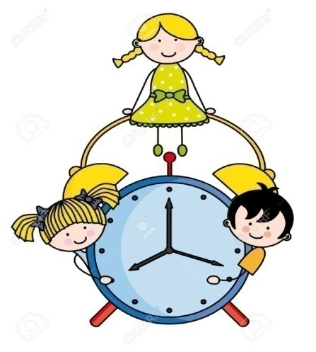
Tell the time

Slide 6
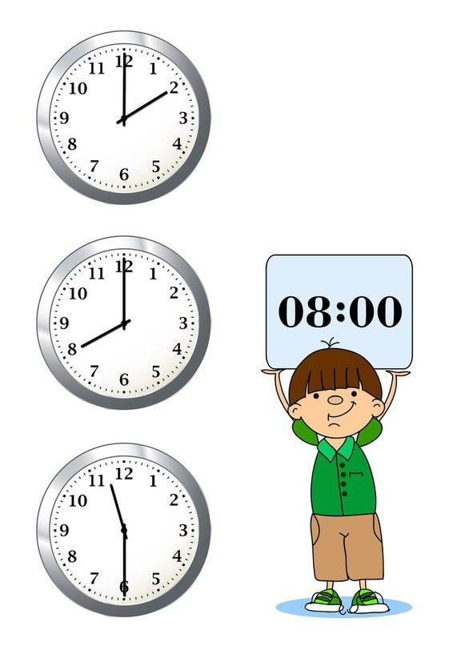

Slide 7
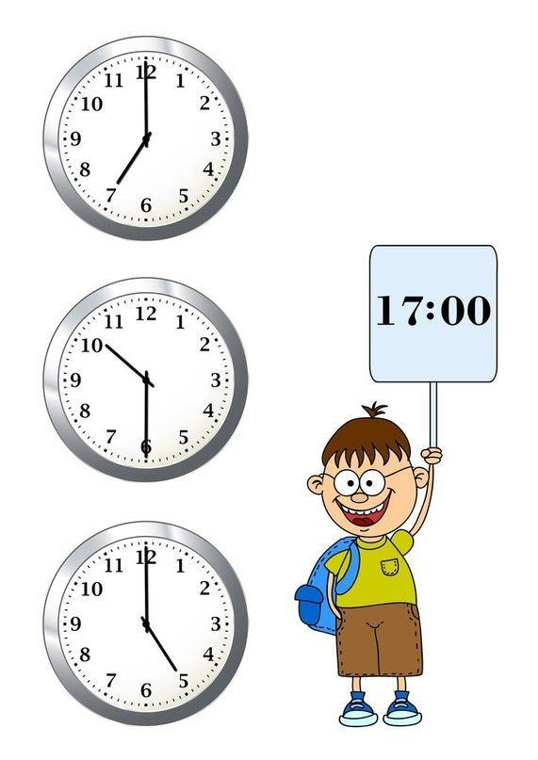

Slide 8
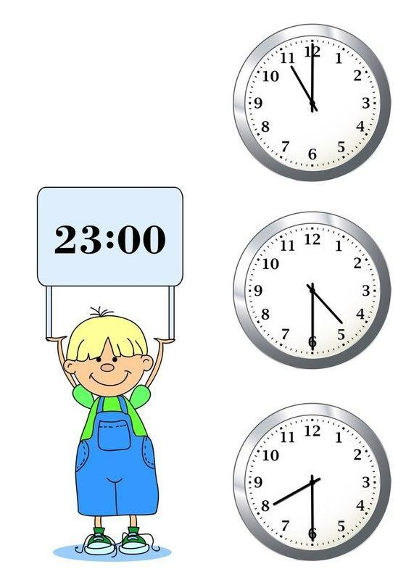

Slide 9
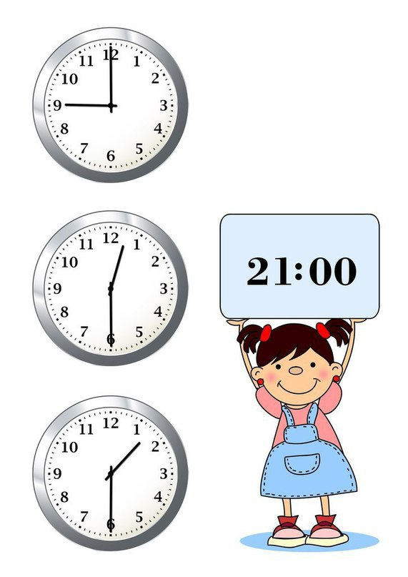

Slide 10
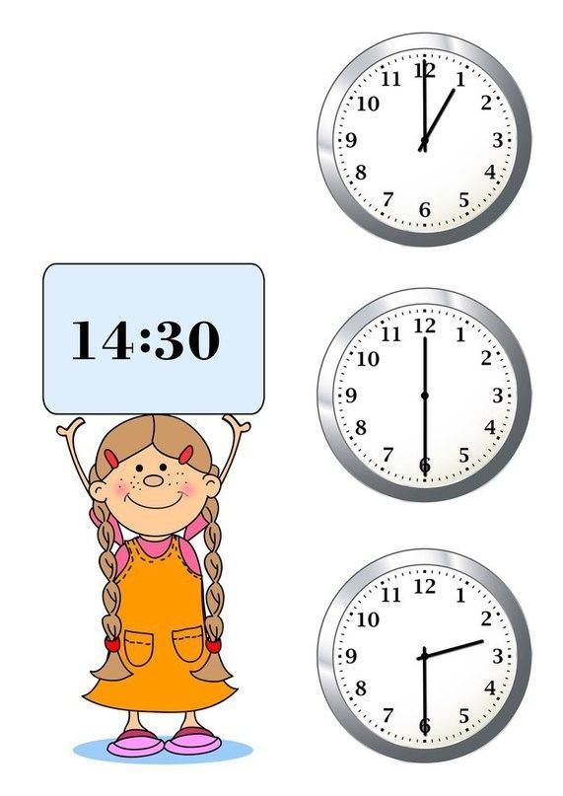

Slide 11
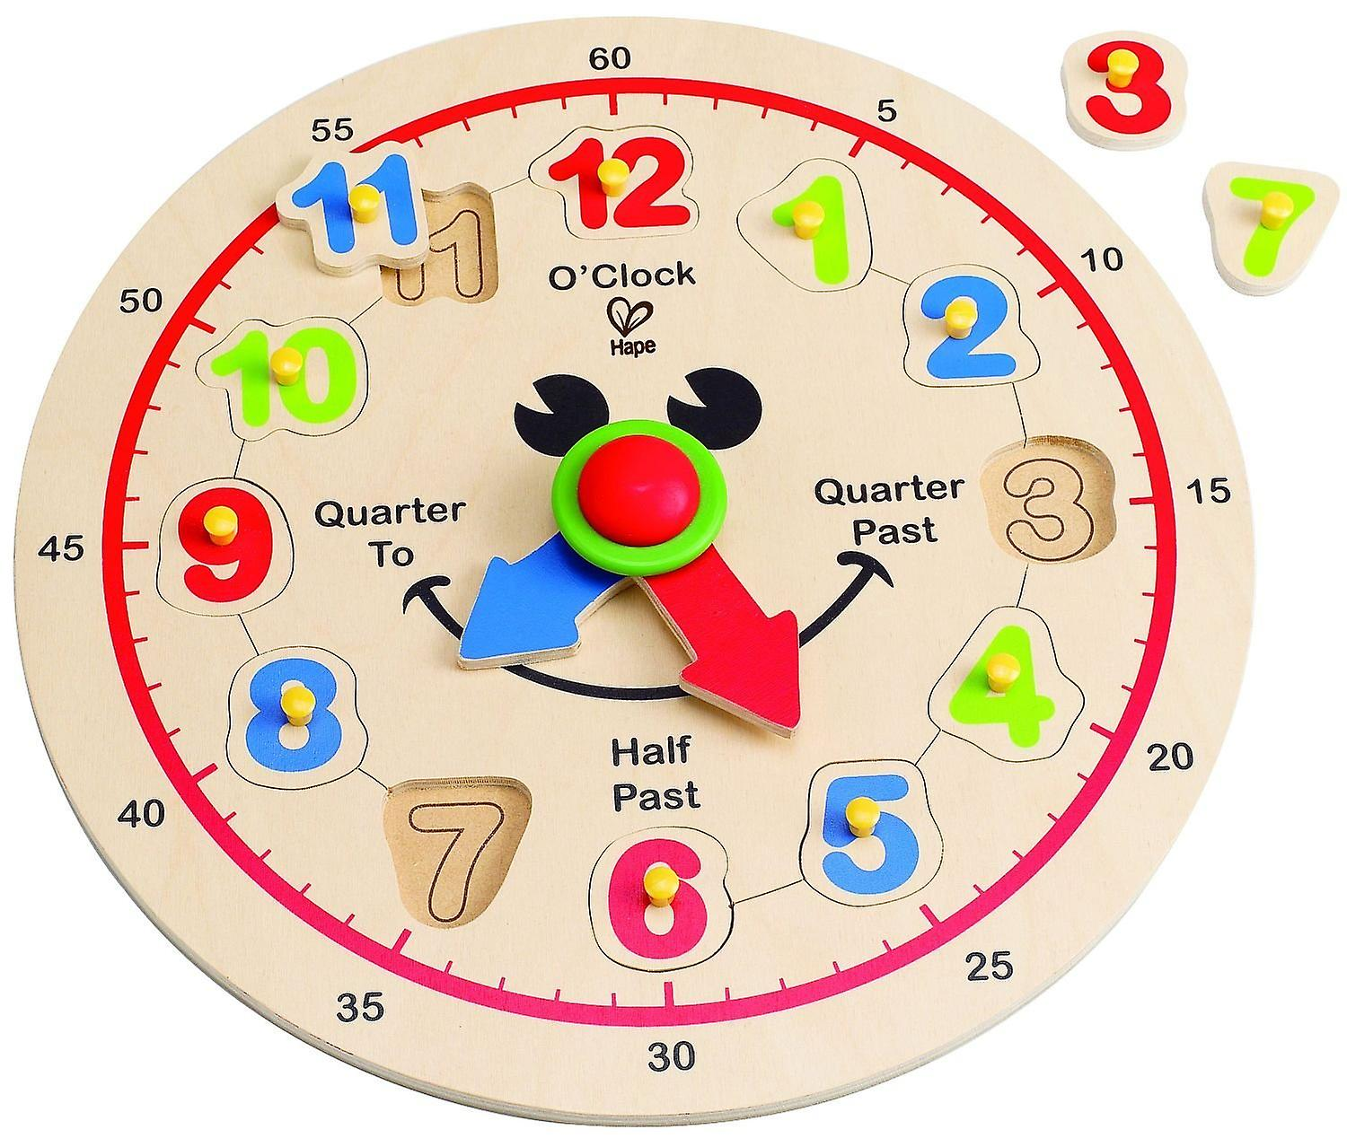
What time is it?

Slide 12
Му Day
Usually I …... at 6.30
I wash…. , clean … , and have …
Then I go …
After school I go …
When I come home, I ….
At … I go to bed.

Slide 13
Му Day
Usually I get up at 6.30
I wash my face and hands ,
clean my teeth , and have breakfast.
Then I go to school .
After school I go home.
When I come home, I do homework.
At ? …I go to bed.

Slide 14
complete the question
ask your classmate to answer it
When do you …… ?

Slide 15
What did he / she answer ?
F.ex.: He / she gets up at 7 a.m

Slide 16
Make up questions from the words
1) do, When, get, you, up ?
2) is, time, it, What, now ?
3)Do, wash, your, hands, you, and, face?
4)do, have, When, you , breakfast ?

Slide 17
When do you get up?
2) What time is it now?
3) Do you wash your face and hands?
4) When do you have breakfast?

Slide 18
Продолжите фразу

Slide 19
Reflection
Clap your hands, if you like the lesson. Everything is clear.
Smile if you have questions
Lift your hanf if you don’t like the lesson.
You’ve been sleeping during the lesson.

